Slide 1
Mrs. Whelan’s First Grade
Class Information
2019-2020
Thank you for coming tonight!
All information can be found on my weebly website:
northwoodses.wcpss.net/School Directory.html
* click on First Grade Teachers and Whelan’s Weebly Site

Slide 2
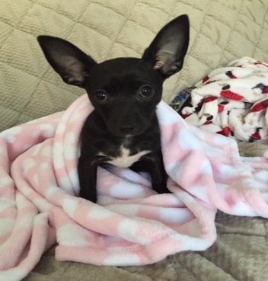
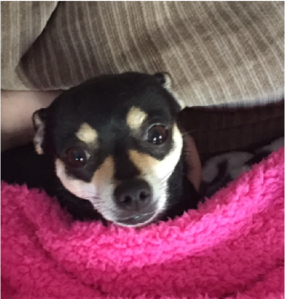
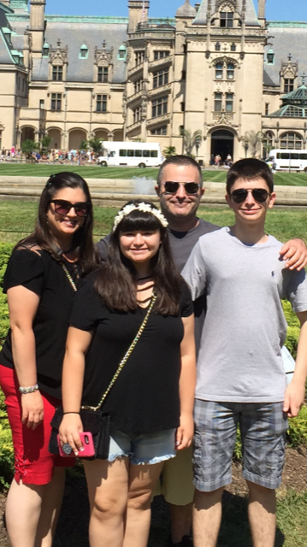
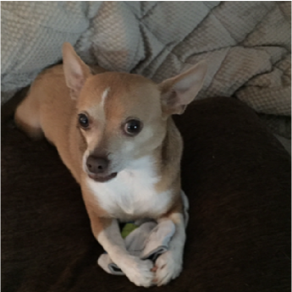
Welcome To First Grade!
Introduction - My Background
I have a Bachelors Degree in Elementary Education (N-6) and a Masters Degree in Reading (K-12). I have been teaching for twenty three years. I taught First Grade in New York for 4 years and then moved to NC. I’ve been at Northwoods for the last 19 years. I taught Kindergarten for 12 years and then moved up to First Grade 7 years ago!

Slide 3
Policies
Rules and Consequences
* Created together and posted
Behavior System
* We use a penny system (calendar comes home daily) – the color of the
penny stamp has no significance
* Children can cash in his/her money once a month for prizes of different
values
PBIS Incentives
* Northwoods is proud to be an exemplar PBIS school, which stands for
Positive Behavioral Interventions and Supports. This is a school wide
program.
* compliments are given to the group for working together and lighthouse
tickets are given to individuals who display CLIMB.
Food
* All food brought into school for the class to share must be store bought.
This is a Wake County policy.

Slide 4



ELA (English Language Arts)
Reading- Based on assessment of skills and reading levels, students are taught on his/her level. Children meet within a small group or individually during our CAFÉ/Daily 5 time. Whole group mini lessons are provided before each round of the Daily 5 as well to teach/reinforce essential skills (ex: predicting, retelling events, short vowels, long vowels, etc).
WCPSS reading benchmarks: 1st Quarter – Level C/D
(minimum requirements) 2nd Quarter - Level F/G
3rd Quarter – Level H
4th Quarter – Level I
Writing - We utilize the Lucy Calkins research based writing program for 30 minutes per day. Again, mini lessons are provided to teach/reinforce essential skills and then children work independently at their level. All children have a writing folder, which is kept inside of their chair pocket. We will switch classrooms for “Koala Time” to meet the needs of our students.
Students will write the following pieces:
Small moment/Narratives
Opinion
How-To’s
All About Books
Authors as Mentors (Kevin Henkes)
Writing like a Scientist or a Historian
All pieces will focus on/be graded on content and conventions

Slide 5


Math
1st Quarter: • Represent and interpret data • Extend the counting sequence • Understand place value • Represent & solve problems involving addition & subtraction • Work with addition & subtraction equations | 2nd Quarter: •Extend the counting sequence • Understand place value • Represent and interpret data • Represent and solve problems involving addition and subtraction • Tell and write time • Work with addition & subtraction equations
3rd Quarter: • Represent & solve problems involving addition & subtraction. • Add and subtract within 20 • Work with addition and subtraction equations • Use place value understanding & properties of operations to add & subtract. • Reason with shapes and their attributes. | 4th Quarter: • Reason with shapes and their attributes • Represent & solve problems involving addition and subtraction • Understand & apply properties of operations and the relationship between addition and subtraction • Add and subtract within 20 • Work with addition and subtraction equations

Slide 6


Social Studies
Our Main Units of Study are:
  * Quarter 1: “I am a Citizen of Many Communities”
  * Quarter 2: “Our Community Celebrates”
  * Quarter 3: “I Can Find my Way Around My Community”
  * Quarter 4: “We Care for Our Community”

Slide 7

Science
Our science curriculum supports an inquiry based learning approach. Students are given the opportunity to use the tools of a scientist through many hands-on activities and experiments.
Our Science units are:
  Living Organisms
  Earth, Moon, and Sun
  Pebbles, Sand, and Silt
  Balance and Motion

Slide 8
Personal Needs
Bathroom
* Students get a pass to use the hallway bathroom as
needed
* We give frequent reminders - before lunch, after lunch, before a
special, and before outside play.
Drinks
* Children can use our water fountain as necessary
Change of Clothes
*All children need a change of clothes - Please include underpants,
socks, and an appropriate outfit for the season we are in. Accidents/spills still happen in first grade.
*Check your child’s backpack daily- if soiled clothes are sent home,
please send in another set of clothing the next day.

Slide 9
Classroom Management
Absence Notes
*Attendance is taken by 9:15 on a computer database. If your child is absent, please
email me at kwhelan@wcpss.net or call the office at 460-3491 as to why your child is
absent (a reason must be coded when I take attendance).
* For my records, please send an absence note/email when your child is absent.
Late To School
*If your child arrives anytime after the 9:15 bell, please make sure they get a late slip
from the office before coming to our classroom (parent should be present).
*Please note that the children do “morning work” from 8:45-9:15.
Changes In the Way Your Child Will Go Home
*A note is needed if you are changing the way your child goes home. Please try to also write
a note if you plan on picking your child up early from school.
Book Orders
* sent home monthly (online orders only)
Notes Home Folders
* Please check and empty them every night. Return it to school daily.
If you have a note/any type of money (lunch money, check for a book order, etc.), please put it in this folder. We are not permitted to go through a child’s backpack.

Slide 10
Assignments
Homework-
*No homework, except reading (Please see note regarding this)
Book In A Bag
*You will start to see books coming home in a Ziploc bag. These are “good fit books” for your child (books on their individual level). Please have your child read all five books twice before returning the whole bag back. Please remember to ask your child questions about the character, setting, main events (in story order), and make connections. Also ask your child about specific parts of the particular story they are reading. A good reader is a strategic reader! It is so important to reinforce the reading strategies we will be teaching in class.

Slide 11
Daily 5 and Cafe
Daily 5
The Daily 5 is a system that teaches children to work independently on five different tasks that they engage in during our literacy block of time (2 rounds a day):
1. Read to Self
2. Read to Someone
3. Work on Writing
4. Spelling/Word Work
5. Listen to reading
This structure fosters meaningful and independent literacy practice, as well as promoting life long readers. While children are engaged in the Daily 5, I am working with groups or individuals on literacy skills.
Café
The Café provides a structure for conferring, a language for talking about reading development, and a system for tracking growth and fostering student independence. Through the use of the Daily 5 and the Café, each child’s literacy program is developed according to his/her own needs.

Slide 12
Academics
*All goals and objectives will be sent home each quarter
Academics
Our daily schedule incorporates the following (please refer to our class schedule for specific times):
Math
Reading
Writing
Daily 5/Café
Science
Social Studies
Technology (computers, smart board, ipad, document camera, & computer lab/laptops)
Specials (P.E., Music, Art, Computer Lab, Reader’s Theater, and Media)
Snack
Outside recess (30 minutes)
When my students leave me at the end of the year, I not only expect them to master skills on a First Grade level, but to gain a positive self esteem and acquire the ability to work together!
Student Support Team - If there is any concern with a child’s academic performance or their behavior (he/she is performing at a level 1 or 2), they may be referred to our Student Support Team. Members of this committee will provide strategies for both parents and teachers to use in order to help him/her improve.

Slide 13
Thank you for coming tonight!
End of 1st Quarter – conference/report card
End of 2nd Quarter - report card
End of 3rd Quarter - report card
End of 4th Quarter – conference/report card
☺ I look forward to an exciting and successful year ☺

